Slide 1
Source of online learning tools in ICT
Noor Fatima
25F-CY-108

Slide 2


INTERNET 🛜
The internet is the most important source of ICT learning tools. It provides access to millions of websites, online courses, video tutorials, e-books, and educational platforms. Students can search any topic, watch lectures, download notes, and communicate with teachers. Search engines like Google, Bing, and Yahoo help students find information quickly.

Slide 3
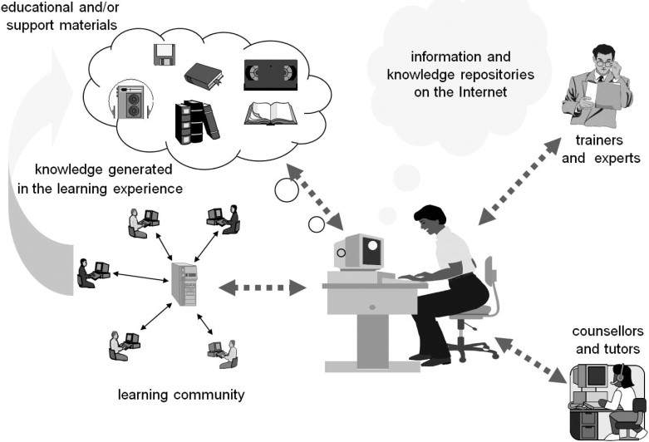
EDUCATIONAL SOFTWARE👩🏻‍💻
Educational software includes programs designed to support teaching and learning. These tools help students practice skills, complete assignments, and understand difficult topics through interactive activities. Examples include MS Office training software, typing tutor programs, math-solving software, language-learning applications, and computer simulations for science labs.

Slide 4

E- Library/ DIGITAL LIBRARy
Digital libraries store books, journals, research articles, and study materials in electronic form. Students can access them anytime using computers or mobile phones. They eliminate the need to visit physical libraries and provide a wide range of updated materials. Examples include Google Books, research databases, and online academic libraries created by schools or universities.

Slide 5

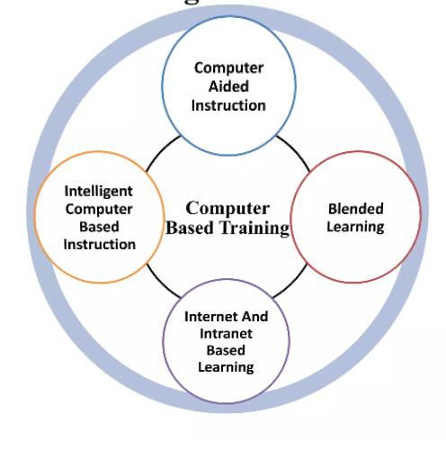
Computer based TRAININg🖥️
CBT refers to learning programs delivered through computers. These include tutorials, animations, recorded lectures, tests, and interactive exercises. CBT materials may be stored in CDs, DVDs, or downloaded from the internet. They allow students to learn at their own pace, repeat lessons, and receive instant feedback through quizzes.

Slide 6
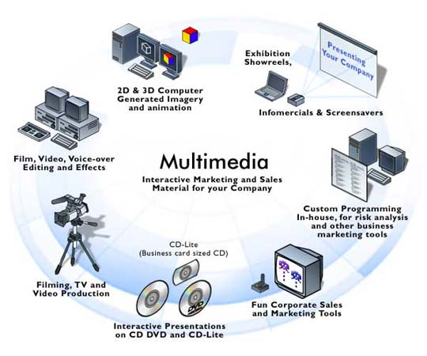
Multi media tools
Multimedia tools use a combination of text, pictures, sound, animations, and videos to make learning more engaging and easier to understand. Examples include educational videos, PowerPoint slides, digital storytelling, simulations, and animations. Multimedia helps students understand complex concepts visually and improves memory retention.

Slide 7

Virtual learning environment
VLEs are online platforms used by teachers to manage courses, upload study materials, assign homework, and communicate with students. They provide discussion boards, quizzes, attendance systems, and grade tracking. Examples include Google Classroom, Moodle, Edmodo, and Microsoft Teams. They help students learn remotely and maintain organized digital records.

Slide 8

Social media & communication tools
Social media platforms are powerful tools for learning and information sharing. Students can join educational groups, watch lectures, participate in discussions, and ask questions. Platforms like YouTube, Facebook, WhatsApp, and Telegram help create study communities. Communication tools like Zoom and Skype enable online classes and live discussions.

Slide 9

.

